Slide 1
Quantifying the text similarity between citations using NLP
M. Sai Anirudh Reddy
I. Naveen Kumar
P. Mohana uma sushmanth

Slide 2
Problem statement
When a person is willing to write a research paper in a particular topic, he goes through all the available work done on this topic in the past. They see all the methods used and the way of implementation. So, when they are creating their own methodology or work this past data will have some impact on them. So, there is a chance for high similarity of the work they cited and their own work.

Slide 3
Objective
The main aim of this project is to know the similarity score of references mentioned in the main paper. The objectives of this project are:
To calculate the similarity rate between main paper and its citations.
Categorize the similarity rate of references with main paper as self-citation, as relevant citations, as non-relevant citations etc.

Slide 4
Methodology
Data collection using
web scrapping
Data filtration
&
Storage
Feature extraction using NLP
Text Similarity check

Slide 5
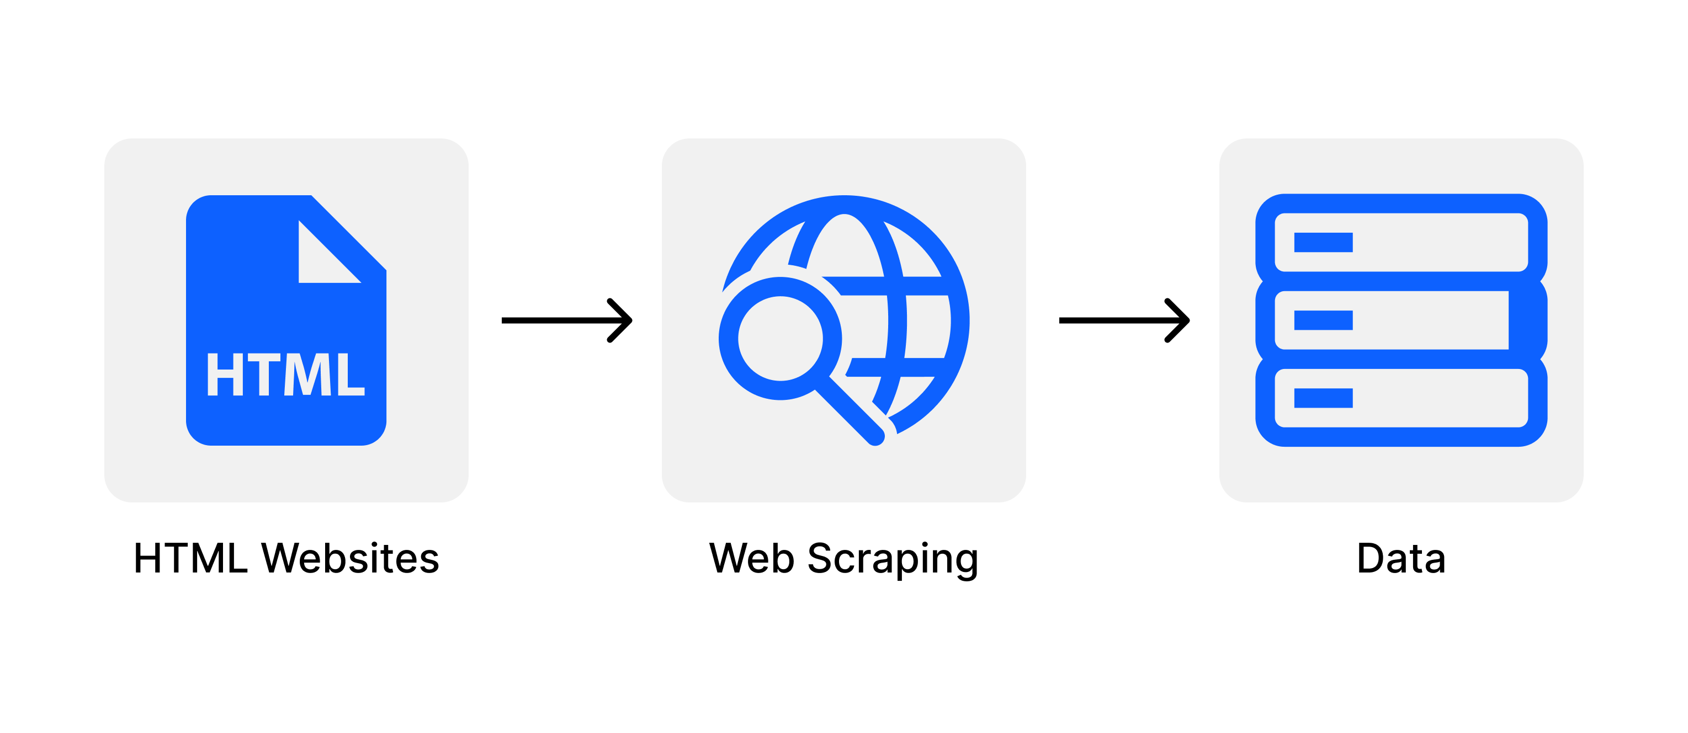
Data extraction
We have collected the publications details from Dimensions which is an open-source platform.
We have extracted the raw data using python modules like requests and beautiful soup.

Slide 6
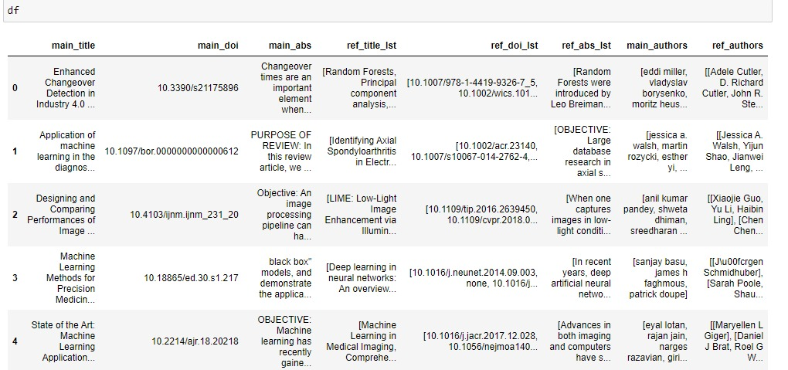
Data filtration & storage
After the data collection, the raw data has been cleaned by removing null values.
And stored in a structured manner in a data frame as per the requirements.

Slide 7
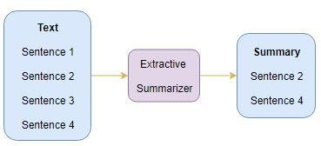
Feature extraction NLP
Extractive summarization technique takes the most important subset of sentences from the whole abstract. So, concatenation of all these important sentences gives the summary of each abstract.

Slide 8
Text similarity
Here, the similarity score of the abstract of each reference with the abstract of the main paper is calculated.
we have used three similarity metrics to calculate similarity score. They are:
Cosine similarity
Glove - Word Embeddings similarity
KL - divergence

Slide 9
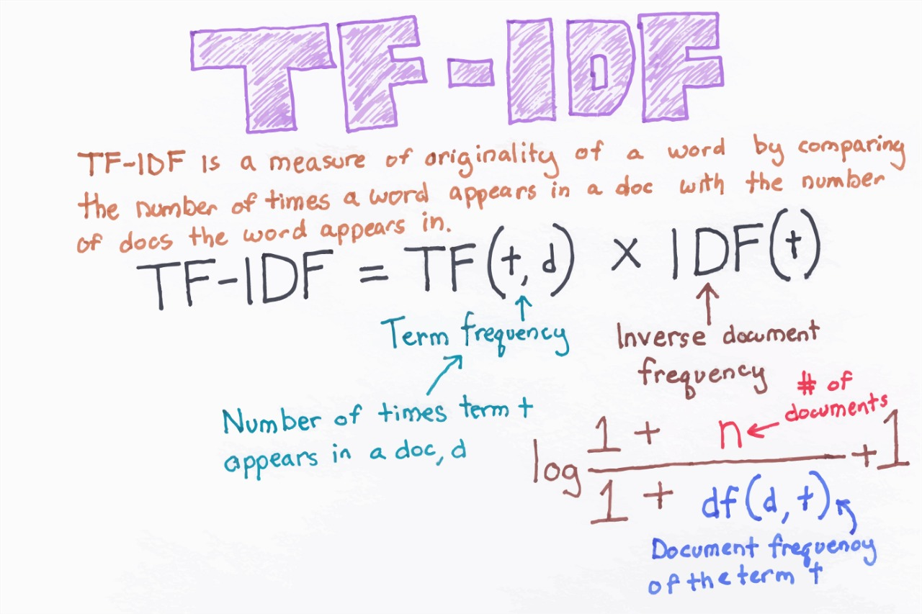
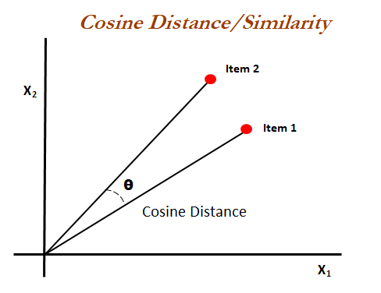
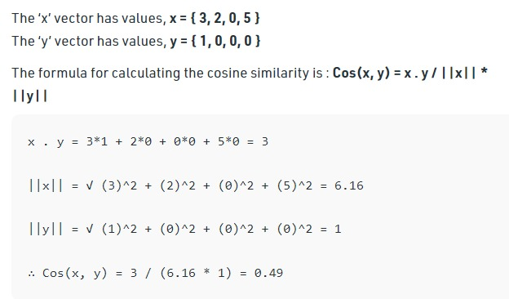
Text similarity
Cosine similarity:
Initially we have used tfidf vectorizer to get the word vectors and inbuilt cosine similarity method is used to calculate the similarity between the main abstract and its reference abstracts and these scores are stored in a list.

Slide 10
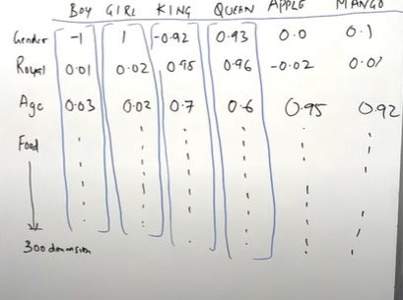
Text similarity
Glove – word embedded similarity:
A word embedding is a form of representing a word in the form of vectors. These vectors are formed by considering the relation between the words like the words with similar meaning will have similar type of representation.

Slide 11

Text similarity
KL - divergence:
This tells how much the two probability distributions differ. Here the Kl-divergence between any two distributions like let's say the two distributions as A and B, it is generally represented as KL(A || B).’||’ indicates the divergence. It is calculated as follows:
KL(A || B) = $ΣX∗A(X)∗log(A(X)/B(X))$

Slide 12
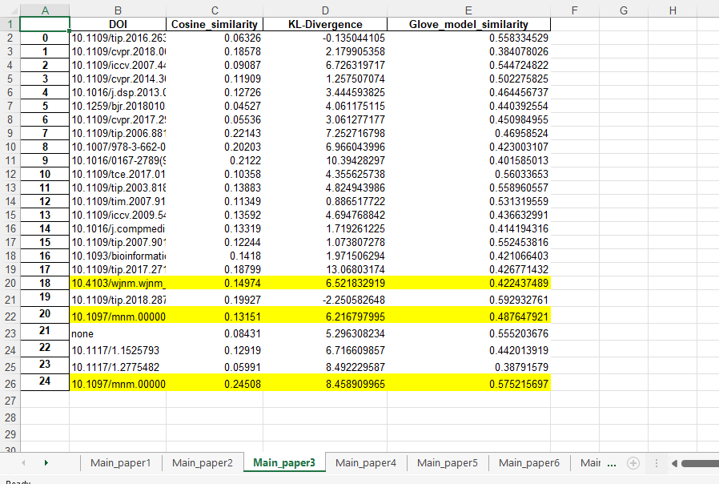
Results
Finally, this shows the similarity rate between a main abstract and its citations. So, we can see that there are 3 papers mentioned that was written by the main paper author that were referred to as self-citations. Here all the scores given by the three metrics shows that the main paper abstract was not that much like the abstracts of self-cited papers.

Slide 13
Thank You

